Slide 1


Responding to Human Trafficking: Complexities and Challenges
Dr. Rosemary Nagy
Nipissing University

Slide 2

Who Are We? & What We Do!
Check out our website at: https://noraht.nipissingu.ca/
Follow us on Facebook at: https://www.facebook.com/CanadaNORAHT/
Notes:
Unique circumstances of the north: remote and rural communities; large geographic distances; diverse Indigenous communities; under-resourced in terms of community-based services (Cochrane – no need for service mapping!)
Inadequacy of putting someone on a bus to head “down south” away from family and community supports
Also: mining as potential factor in trafficking;

Slide 3
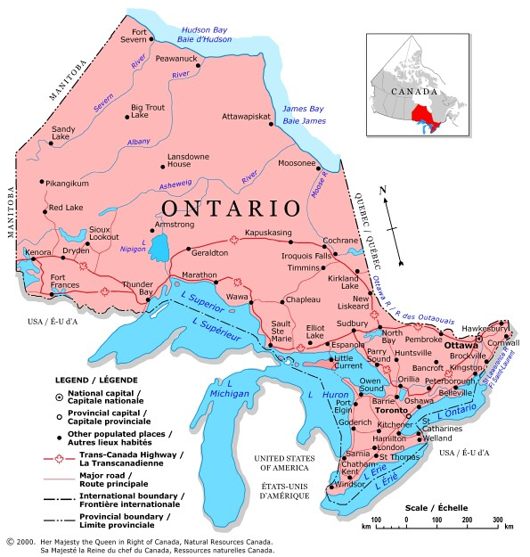
Notes:
This is our region as we’ve defined it – but people are being trafficked down the 401 corridor or westward toward Thunder Bay.

Slide 4
Our objectives:
To identify gaps and barriers in service;
To develop best practices for the north;
To forge relationships for regional coordination;
To make social policy recommendations;
To mobilize and share knowledge.
Notes:
Our assumption is that almost all human trafficking in our region is for the purpose of sexual exploitation, and that Indigenous women and girls will be over-represented.
We aim to take a feminist intersectional, decolonial approach to our work. We seek to implement participatory action research, which involves people as co-generators of knowledge, rather than as research subjects.
-service provider baseline survey
Interview and literature research on best practices

Slide 5
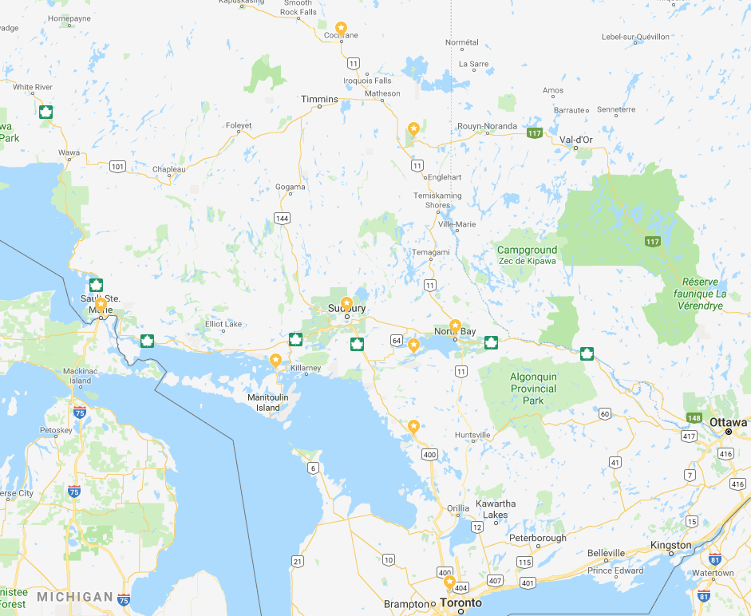
8 PAR workshops – 2017
North Bay
Sudbury
Little Current
Sault Ste Marie
Cochrane
Kirkland Lake
Dokis First Nation
Parry Sound
161 participants. 60 Indigenous.
5 with lived experience.
Notes:
Gaps and barriers to accessing services for persons who are being trafficked or sexually exploited.
Follow up conferences just this past month – Timmins, Sudbury and Sault Ste Marie.

Slide 6
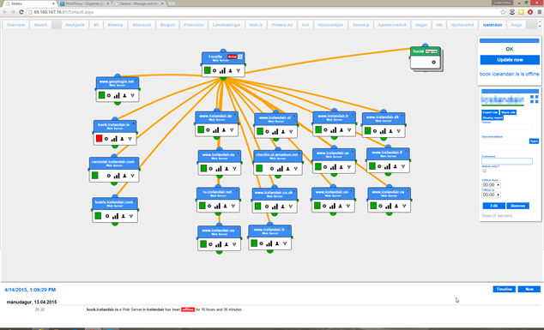


Next Steps
Service Mapping
Local process
We can assist
Toolkits
Indicators
Numbers??
Education
For service providers
Notes:
Just finished 3 follow up conferences this fall.

Slide 7
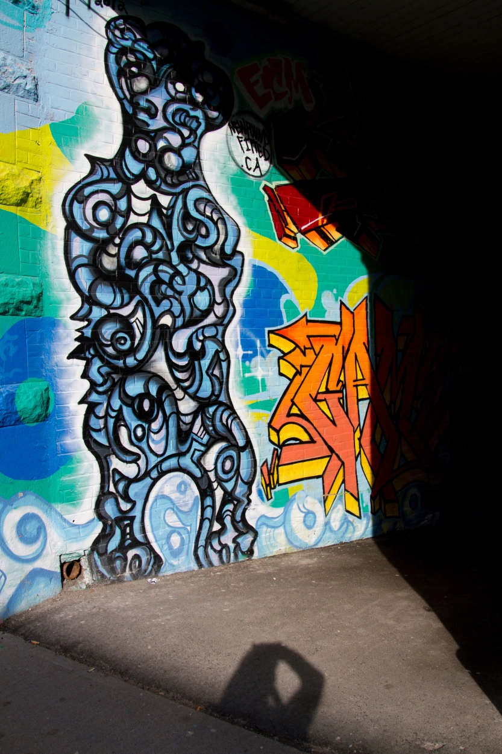
What is Human Trafficking?
Photo by Gina Snooks

Slide 8
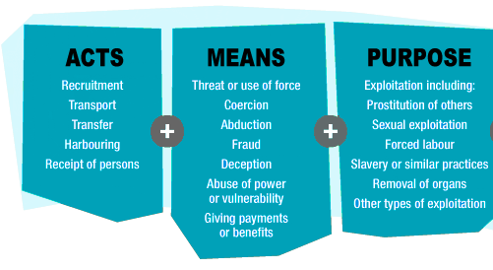
Human Trafficking
=
Source: Coalition for Assisting Trafficking Individuals (CATI), London / United Nations, Palermo Protocol
Notes:
Let’s start with the question of, what is human trafficking? This actually is not a simple question; there is much conflict, ambiguity and debate over what falls under the umbrella of human trafficking, particularly when it comes to trafficking for the purpose of sexual exploitation.
Traffickers undertake ACTION using MEANS for the PURPOSE of exploiting people.

Slide 9
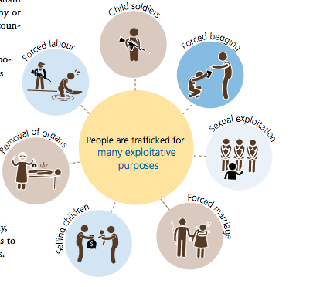
Source UNDOC 2016 Report on Trafficking in Persons
Notes:
Sexual exploitation and forced labour are the most common forms of human trafficking.
Our focus on NORAHT is human trafficking for the purpose of sexual exploitation – women (girls, boys, men, transgender and 2 spirit also affected)
ILO:
Forced labour: under menace of any penalty
Slavery: powers attaching to the right of ownership are exercise
Human Trafficking: three elements: means, act, purpose

Slide 10
Sexual exploitation?
All prostitution is inherently exploitative.
Sex work is chosen and is not the same as trafficking
Notes:
When the Palermo Protocol was being negotiated, there were two main feminist camps: one that wanted to see all prostitution abolished (the abolitionist camp, notably the US-based CATW, co-founded by Kathleen Barry) and the other that was pro-sex work and saw a clear distinction between prostitution and human trafficking (pro-sex work camp, notably, Thailand based GAATW)
Both camps obtained partial victories with the Palermo Protocol. Abolitionists succeeded in retaining explicit reference to “prostitution” as the end purpose of human trafficking, alongside the newly expanded end purposes of forced labour, servitude, slavery and the removal of organs (Gallagher 2001, 986). Human rights feminists succeeded in having the elements of force, coercion and deception brought into the law, thereby tacitly securing the legitimacy of voluntary migrant sex work. However, the Palermo Protocol addresses prostitution only in the context of trafficking, and it is without prejudice with regard to domestic laws on prostitution (Gallagher 2001, 986). The end purpose of human trafficking, “the exploitation of the prostitution of others,” is ambiguous and open to interpretation (Chuang 2014, 1616).
Bush Administration: conflated prostitution with trafficking. Tremendous influence on international approaches.
Also, it is notable that the Palermo Protocol is not a human rights document. It is a supplement to the UN Convention against Transnational Organized Crime.

Slide 11

Canadian Law
Criminal Code: 279.01 (1) Every person who recruits, transports, transfers, receives, holds, conceals or harbours a person, or exercises control, direction or influence over the movements of a person, for the purpose of exploiting them or facilitating their exploitation is guilty of an indictable offence…
Notes:
IRPA also includes a section on bringing people into the country through recruitment, transportation, harbouring or receipt of persons by means of abduction, fraud, deception or use or
threat of force or coercion (exploitation not in this definition!)
According to StatsCan, about one third of police-reported incidents from 2009 to 2016 involve cross-border trafficking (Ibrahim 2018). Ninety-five percent of all victims are female and 70% are under the age of 25 (Ibrahim 2018). It is likely that the majority of trafficking cases, domestic and international, are for sexual exploitation (RCMP 2010, 2012, 2013).

Slide 12

Control of Movement is key
Notes:
This is a broader definition of human trafficking than the Palermo Protocol because the “means” – the element of coercion, fraud, or deception – is absent. Further, no actual physical movement is required. Rather it is the control of movement and the possibility of exploitation that matter in the Canadian definition of trafficking (Roots 2013; Sikka 2009; Burgess 2014).
Katrin Roots has argued that the emphasis on control of movement is “strikingly similar” to the procurement (“pimping”) provisions in the Criminal Code.

Slide 13
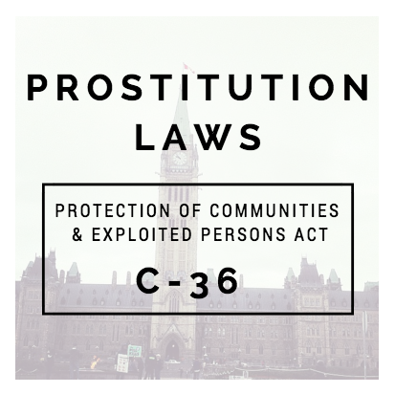
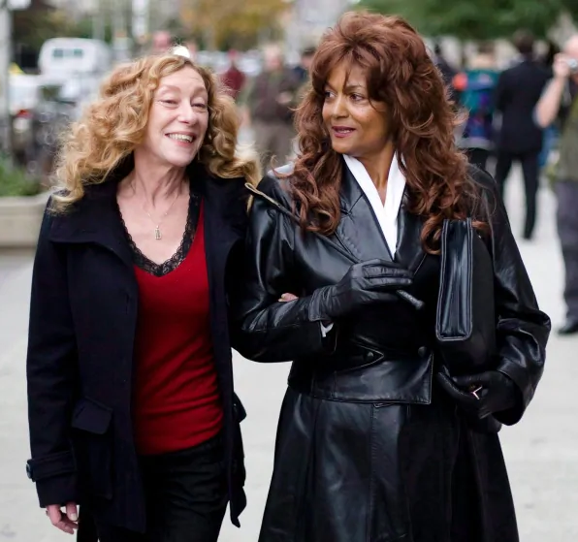
Looming over anti-trafficking
Bedford v. Canada (SCC 2013)
Notes:
Bedford v. Canada 2013. (photo of Valerie Scott and Terry-Lyn Bedford
, the 2014 Protection of Communities and Exploited Persons Act (PCEPA), follows the “Nordic model” by criminalizing the purchase and advertising of sex services, looms over Canadian anti-trafficking. The bill states in its preamble that exploitation is “inherent in prostitution,” and it supports the exit of “prostituted” women. When passed, the then Minister of Justice implied that the PCEPA would help to reduce the rates of human trafficking in Canada

Slide 14

“All sex acts performed for an exchange of money…even when the person is of the age of consent, is a form of sexual exploitation and may be deemed sex trafficked” (2014 report)
Notes:
ONWA: there is a “gray area” between prostitution and trafficking”.
“[I]t is not a choice when one’s life has been groomed through abuse and poverty to be sexually exploited” (NWAC noting Farley et al’s argument 2014 report, p. 59)

Slide 15

Sex work is a job selling some form of sexual service. It is a “pragmatic sensible response to a limited range of options.” Trafficking is coerced or forced labour.
Notes:
Selling sex is a pragmatic and sensible response to a limited range of options. Where people are doing sex work but would rather not be, it is this lack of options that is the problem – not sex work itself.
Women, young people, trans women, people of colour and Indigenous people often face limited economic options. For many, sex work is the best or only option for work and we work to improve the conditions of work.
Sex worker empowerment stops human trafficking. Maggie's supports effective, evidence-based solutions to the problem of human trafficking that locates sex workers as a key part of the solution. We support open borders and labour and human rights for undocumented workers.
Note: there are Indigenous sex work advocates (Sarah Hunt, Naomi Sayers); there are former sex workers who take the abolitionist position. I am just picking a couple of noted Canadian organizations to give you a sense of the array of debate

Slide 16
Participant comments
“Intimate partner trafficking them: this is all they know. Usually unaware that trafficking is illegal.”
“People are brainwashed into sex trafficking”
“Women at risk are those who cannot afford rent, often exchanging sexual favors for rent.”
“Not people nabbing girls, but young girls prostituting themselves for drugs and being used”
Notes:
Participants conflated human trafficking with survival sex and drug trafficking.

Slide 17
Participant comments
Human trafficking “might look like domestic violence, sexual assault, drug charges”
“No clear understanding of the difference between choosing to be sex worker and being sucked into human trafficking”
Spectrum of sex worker to trafficking, and women are fluid along the spectrum
Notes:
Participants conflated human trafficking with survival sex and drug trafficking.

Slide 18

Collaboration?
Comprehensive
Harm reduction
Non-judgmental
Culturally sensitive
Trauma-informed
Flexible, 24/7 support
Long-term commitment
Notes:
So, how do we as a region come together in order to respond to human trafficking? Many communities in the north do not have the luxury of size that would let us work with like-minded people. The ideal practice would be to have a dedicated safe house and organization for human trafficking. But this is not going to happen anytime soon. Thus, it is clear that collaboration across multiple sectors is needed in order to respond to human trafficking: first responders, mental health and addictions, sexual assault centers, shelters, transitional and long term housing, Indigenous supports, francophone supports, ODSB, child protection services, police services, victim services, corrections, probation and parole…
Harm reduction and non-judgmental: Rather than focusing on labels – it is important o focus on the harms, risks and indicators of human trafficking. Best practices research: interview respondents filled a whole political spectrum but we heard affirmations from various organizations that they are willing to help anyone who asks for help, regardless of how that person self-identifies or whether they decide to stay in the sex trade or leave.
It is also important to note that human trafficking may present as something else: domestic violence, a parent-child conflict or a “complicated relationship” rather than “desperation and needing to escape”. Some people may not wish to disclose that they have been trafficked or they will reject the trafficking label.
Cuturally sensitive:, mental, physical, emotional and spiritual
Trauma informed: placing the survivor’s safety, choice and control as a priority; learning, collaboration and trust; healing in relationships(indigenous perspective especially)
Long-term commitment: One respondent told us:
“When they are in hotel rooms, they aren't psychologically present. They shut down. Afterwards, it can take months to build trust, then months to look at the intensity. Compared to mainstream rape survivors, we need to magnify their needs by one thousand. Their needs are just so complex, and therapeutic needs, they won't be healed in a year. They need deprogramming. They have been tortured psychologically. If you can't commit the time, then don't get engaged at the outset “
1 to 4 years to exit.

Slide 19
How should we respond to human trafficking without becoming part of the anti-Trafficking problem?

Slide 20
The Anti-Trafficking Problem
“Collateral Damage” (GAATW 2007)
CBSA Deportations (see Butterfly 2015)
Operation Northern Spotlight: “repeatedly experienced” by sex workers as intimidation, harassment, and violation of privacy (Kempadoo and McFadyen 2017, 13).
Notes:
Globally:
Sex workers, migration and refugee advocates, and human rights feminists identify the “anti-trafficking problem” as the “collateral damage” (GAATW 2007) that ensues when governments, law enforcement, border control, or humanitarian organizations pursue anti-trafficking campaigns or policies. Specifically, critics argue that anti-trafficking efforts and rhetoric have resulted in the increased surveillance and therefore decreased safety of sex workers, the criminalization and deportation of migrant sex workers, repressive border controls, individualized approaches, and “rescue” efforts that do not fit the myriad realities experienced by people in the sex trade. “Rescue” may deliver people right back to the miserable situation they first sought to escape (Thrupkaew 2009; Hoyle, Bosworth, and Dempsey 2011). Consequently, a woman may choose “not to identify herself as a ‘victim of trafficking’ – in order not to become a victim of anti-trafficking” (Sanghera 2007, viii).
Furthermore, the anti-trafficking problem relates to the disempowering, moralizing and marginalizing construction of victimhood, and the ways in which “rescue” and “protection” serve to securitize borders against the racialized other while buttressing the West, white masculinity in particular, as “saviour.”
In Canada
Anti-trafficking investigations by the Canadian Border Services Agency (CBSA) in Ottawa resulted in the deportation of 11 Asian women in 2015 (CBC News 11 May 2015).
The RCMP-led Operation Northern Spotlight, which is part of an FBI-Canada collaboration, has been “repeatedly experienced” by sex workers as intimidation, harassment, and violation of privacy (Kempadoo and McFadyen 2017, 13).
Anti-trafficking legislation in the form of criminalizing prostitution serves to tighten the net around sex workers and decreases their safety (Brock 2014; Rose 2015/2016; Kempadoo and McFadyen 2017; Kaye 2017; Grant 2018).

Slide 21
The Anti-Trafficking Problem
“Protecting Innocents”: good victims and bad prostitutes
Emphasis on law enforcement over structural violence, labour rights, development, etc.
Notes:
Moralizing narratives of “protecting innocents” means that “a victim’s failure to experience or frame her experience in terms of a typical trafficking narrative may deny her the status of an ‘ideal victim’ and the credibility that attaches to it” (Hoyle, Bosworth, and Dempsey 2011, 322). Ignoring the complex reasons why (migrant) women may enter the sex trade, this narrative dichotomizes between “good victims” who were forced and are “deserving of new opportunities,” and “bad prostitutes” who knowingly choose the profession and “whose experiences are ignored” (Rodríguez-López 2018, 63). Those who do not fit the ideal victim type—those who are not “entirely innocent or unaware,” those who resist rescue or who do not wish to exit the sex trade—are cast as morally culpable deviants who are undeserving of human rights and subject to criminalization (Rodríguez-López 2018, 64; see also Uy 2011; Baker 2013; Jeffrey 2005).
Individualized approaches – problematic. Yes, it is important to support one person at a time, but this is a band-aid fix.

Slide 22
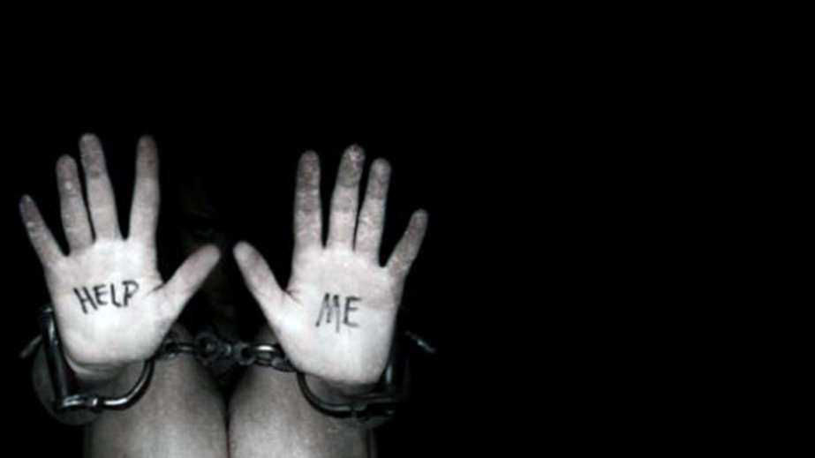
Challenging the Rescue Narrative
Notes:
Sensationalized Hollywood image of the blond girl kidnapped by racialized men. Liam Neesom’s “Taken” – he rescues his daughter and in the process redeems his masculinity (a white masculinity, of course).
Posters with chains – some more sensational than others… Most of the serious research in the field shows that outright kidnapping isn’t typically the case. We did hear of one such case during our workshops –…but we also heard more insidious situations of grooming, love, drug dependency and so forth.
-- There are really complicated structural factors: intergenerational trauma, poverty, and so forth.
While cases such as in the picture certainly do take place, often human trafficking is far more complicated than this:
A woman knowingly—although illegally-- migrates to Canada to be an exotic dancer. Once she arrives, the conditions of her pay are much, much lower than she was led to believe, but she has incurred a huge debt to those who brought her over, and must pay it off. She also is too ashamed and afraid to return home because the traffickers threaten to tell her family.
In the past, a woman has resorted to sex work at the end of the month to makes ends meet. But she has since met a man who showers her with gifts, money and tells her he loves her. A month down the road, he tells her he has lost his job and he needs her to pay him back. He suggests that she turn a few tricks, since she has done this before and she reluctantly agrees. But his demands for money and for prostituting her out escalate, and he uses violence against her. She thinks about leaving him and the general situation, but has nowhere to go.
So we need to be sensitive to the “gray area”.
We don’t want to miss people who live in the gray area – at the same time, we don’t want to every bad thing that exists out there as human trafficking.

Slide 23

Empowerment, Agency &
Self-Determination
“We need to suspend the ongoing creation of Western stories of damage and harm. Otherwise the statistics become toxic narratives that are not situated within lives of resistance and strength, nor placed in historical and changing place and time”
Natalie Clark
“Red Intersectionality and Violence-informed Witnessing Praxis with Indigenous Girls” (2016)
Notes:
Not downplaying the severity of human trafficking and sexual exploitation. We recognize that for human trafficking and sexual exploitation to occur there is an element of loss of control (or lack of agency). We acknowledge the severity of physical, psychological, emotional and spiritual violence that occurs.
Things to consider:
people have complicated relationships with people who harm them in other ways, folks can also have complicated relationships with people who exploit them.
People can determine their experiences for themselves.
Issues around language. For example, We encountered tensions regarding the autonomy of sex work, a lack of understanding or agreement as to what constitutes human trafficking, the use of problematic terminology such as “girls” and “victims” that denies people’s agency, self-determination and empowerment.
People can and do make choices on a spectrum based on various influences at any specific time, including choices to participate in sex work. This does not mean that they do not have choice.
Stories of resistance and resiliency can be embedded within stories about experiences of harm
SWANS: Language of “girls” is infantilizing. SWANS insists trafficked persons must have agency to make own choices and should not be considered victims. Many have been victimized, yes, but “victim” is not their identity. SWAN advocates that some youth enter sex trade willingly and should be view as acting with agency not as victims.

Slide 24

Centering Voices of Lived Experience
Peer-to-peer support;
Survivor voices lead the process;
Hire people with lived experiences as consultants.
Include sex workers – they can and should be at the forefront of detecting cases of human trafficking
Notes:
Nothing about us without us is for us — often used within disabilities activism but applies to all social justice movements. It means that people with lived experience are the experts of their own own experiences and that policies and programs should not be created without the input of those most impacted. In this case, it means listening to the voices of those who have experienced human trafficking and the sex trade and those closest too them.
A significant challenge is that it is difficult to reach out to people with lived experience for numerous reasons. Some of these reasons are obvious like we don’t know how to reach them and it can be dangerous to attempt to contact people who are being trafficked not only for the person being trafficked but also for those trying to reach out.
People who are no longer in crisis mode but who have experienced trafficking may not want to share their insight with us (researcher, service providers, etc) for a variety of reasons; including, but not limited to, the ways in which human trafficking discourse is sometimes framed to suggest that folks who have experienced or are experiencing trafficking do not know what’s best for themselves or that they do not even know that they are being trafficked, which is a phrase we heard numerous times in our PAR sessions. Stigma is another reason.
That said, we also encountered a fair share of participants who advocated for the more spaces led by people with lived experience:
Peer to peer support
Hire people who have experienced human trafficking and sexual exploitation as consultants to mobilize outreach
Create local committee & people with lived experiences should be on committees
With respect to creating educational materials participants said that people with lived experience & frontline workers should be lead the way.
In Cochrane/KL specifically participants said:
People are experts in their own lives: they will know what is best and what they want
Need the help of survivors & consumers
It will also be helpful to include the voices of people who do sex work - sex workers can and should be at the forefront of detecting cases of human trafficking

Slide 25
“Kids aren’t going to listen to teachers or service providers. Need person with current or recent lived experience. That’s who those kids will listen to. Thinking about the time I slipped through the cracks, I wouldn’t listen to teachers, probation officers, the people I would listen to were people on the streets. So I would ideally like to hear from people who are currently or had just left the trade….” (Manitoulin Island)
Notes:
In my own experience I was not in schools, not accessing social services. I was in Tim Hortons getting high. That information wasn’t there. There wasn’t a poster on the wall next to the needle pin about where to get help.

Slide 26

Why and How?

Slide 27
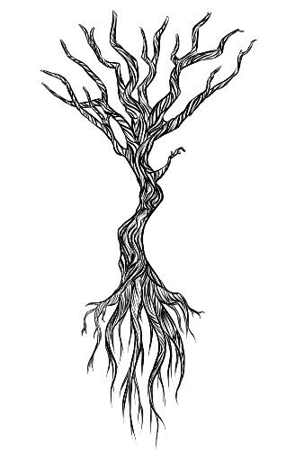
Root Causes
Poverty and Inequality
Racism
Colonization and legacy of residential schools
Domestic violence / VAW
Substance abuse
Neurobiology of trauma and mental illness
Exposure to child welfare
Male demand
Notes:
Pimping culture; culture that ignores racialized sexual violence and violence against women; patriarchy/male demand

Slide 28
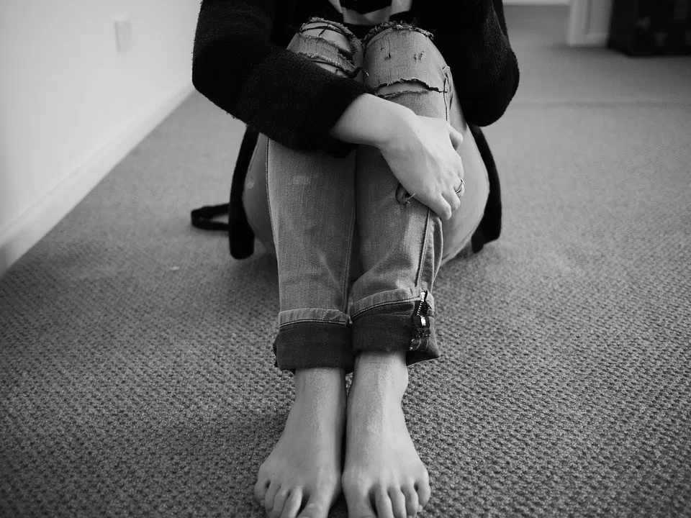
Vulnerabilities
Loneliness
Need for a sense of belonging
Isolation
Lack of awareness
Family dysfunction
Drug/alcohol use
Homelessness
Attraction to fast money
Notes:
Internet –
Recruitment and Entrapment
Luring
“Grooming”
Manipulation and abuse
Drug dependency
Sense of belonging or love
Promise of a better life

Slide 29
Thank you! Miigwetch!!
noraht.nipissingu.ca
rnagy@nipissingu.ca
noraht@nipissingu.ca

